Slide 1
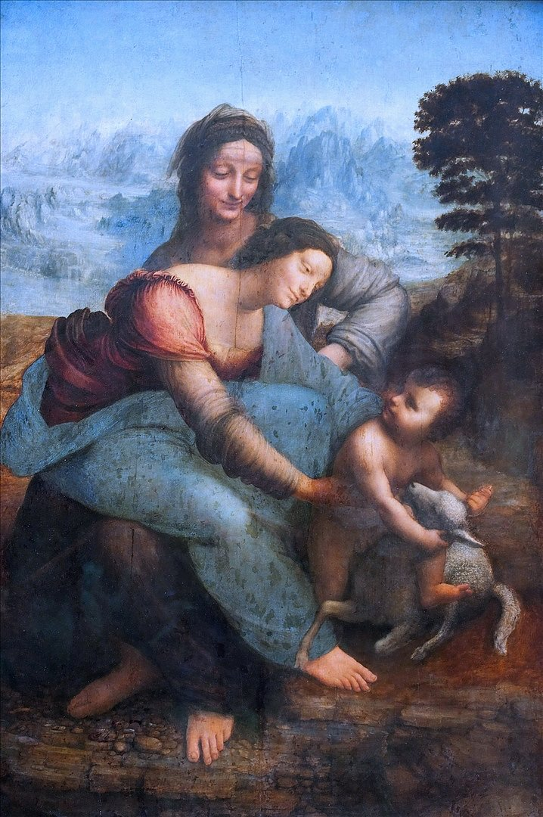
Saint
Ann
Exploring the Iconography of Mary’s Mother

Slide 2
Iconography
What is it?
What is its purpose?
the science of identification, description, classification, and interpretation of symbols, themes, and subject matter in the visual arts
Iconography is the use of images and symbols to portray a subject, movement or ideal.

Slide 3
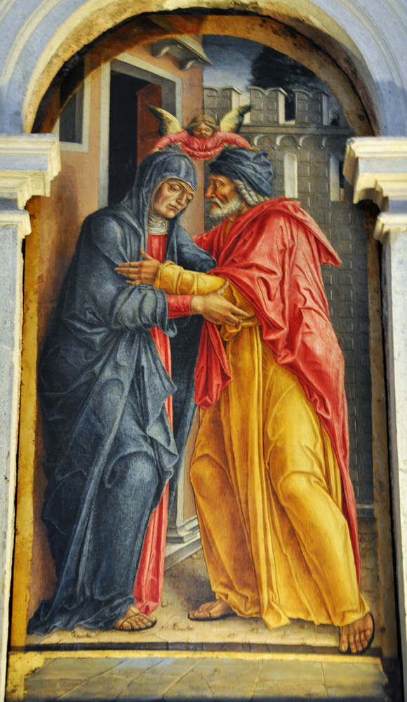
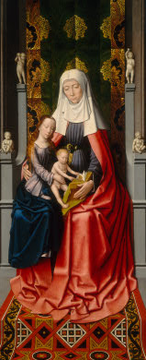
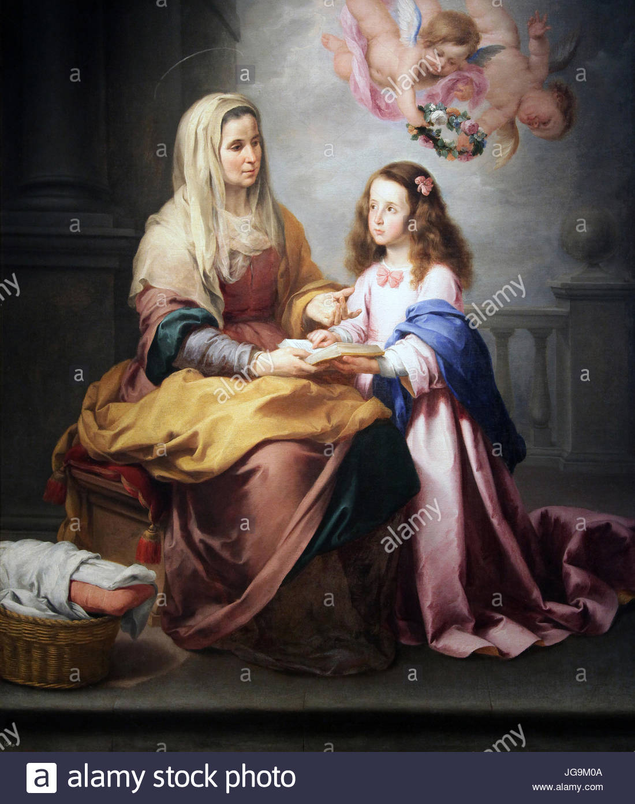
The Evolution of Saint Anne
Bartolomeo Vivarini, Saint Anne and Saint Joachim at the Golden Gate, 1474
Tempera on panel, 41 x 20 in. (104 x 50 cm.)
Church of Santa Maria Formosa, Venice
Gerard David, Anna selbdritt
Dutch, ca. 1500-1520
Washington, National Gallery of Art
Bartolomé Esteban Murillo. Education of the Virgin, Spanish, ca. 1665,
Museo del Prado
Early Imagery
1400- 1500’s
1600-1700’s
Golden Gate
Birth of Mary
Anna Selbdritt
Throne of Wisdom
Teacher
Mother

Slide 4
Early Imagery
The Golden Gate and the Birth of Mary
Bartolomeo Vivarini, Saint Anne and Saint Joachim at the Golden Gate, 1474
Tempera on panel, 41 x 20 in. (104 x 50 cm.)
Church of Santa Maria Formosa, Venice

Slide 5
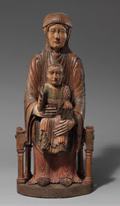
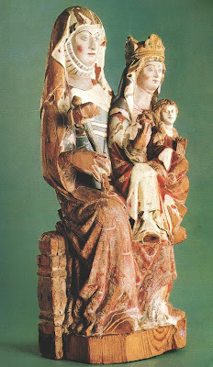
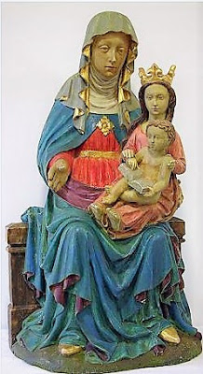
1400 -1500’s
Gerard David, Anna selbdritt
Dutch, ca. 1500-1520
Washington, National Gallery of Art
Anna Selbdritt and The Throne of Wisdom
"Sedes Sapientiae" wooden statue, France (Auvergne), 1150-1200, New York, Metropolitan Museum of Art, The Cloisters
Virgin and Child with St. Anne (Anna selbdritt)
Spanish, 1270-1290
Budapest, National Museum
Anna Selbdritt
German,1400-50
Minden Cathedral Treasury
Bartolomeo Vivarini, Saint Anne and Saint Joachim at the Golden Gate, 1474
Tempera on panel, 41 x 20 in. (104 x 50 cm.)
Church of Santa Maria Formosa, Venice

Slide 6
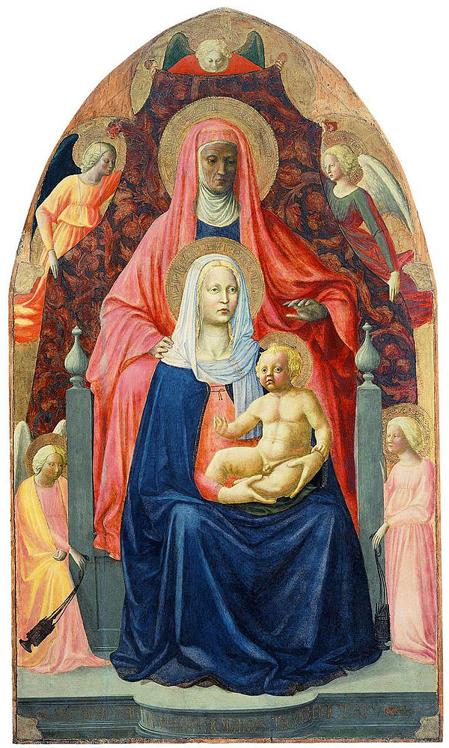
Left:
Masaccio, Madonna and Child
with St. Anne
Italian, 1424
Florence, Ufizzi Gallery
Right:
Leonardo da Vinci,
Madonna and Child with
St. Anne
Italian, c. 1510
Paris, Musee du Louvre

Slide 7
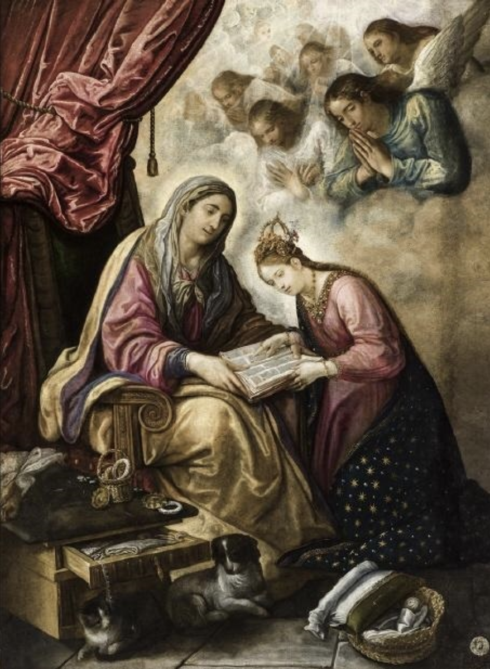
1600 - 1700’s
Mother and Teacher
Juan de Roelas,
Education of the Virgin, cs. 1610,
Museo Provincial de Bellas Artes, Seville
Bartolomé Esteban Murillo. Education of the Virgin, Spanish, ca. 1665,
Museo del Prado
Bartolomeo Vivarini, Saint Anne and Saint Joachim at the Golden Gate, 1474
Tempera on panel, 41 x 20 in. (104 x 50 cm.)
Church of Santa Maria Formosa, Venice

Slide 8
